Slide 1

APEX INSTITUTE OF TECHNOLOGY
DEPARTMENT OF COMPUTER SCIENCE & ENGINEERING
Statistics for Data Science(23CSH-233)
Faculty: Prof. (Dr.) Madan Lal Saini(E13485)
Lecture – 29
Method of Least Square
DISCOVER . LEARN . EMPOWER

Slide 2
Statistics for Data Science : Course Objectives
COURSE OBJECTIVES
The Course aims to:
To equip students with the skills to summarize and interpret data using descriptive statistics and visualization techniques.
To develop a foundational understanding of probability and its applications in data science.
To enable students to perform hypothesis testing and construct confidence intervals for statistical inference.
To teach students how to build and assess linear and logistic regression models for predictive analysis.
To provide hands-on experience with statistical software for data manipulation, analysis, and visualization.

Slide 3
COURSE OUTCOMES
On completion of this course, the students shall be able to:-
CO1 | Summarize and describe the main features of a dataset using measures such as mean, median, mode, variance, and standard deviation, as well as graphical representations like histograms, box plots, and scatter plots.
CO2 | Understand of probability theory, including concepts such as random variables, probability distributions, and the law of large numbers, enabling them to model and reason about uncertainty in data.
CO3 | Apply/perform statistical inference, including hypothesis testing, confidence interval estimation, and p-value computation, to draw valid conclusions from sample data about larger populations.
CO4 | Apply linear and logistic regression techniques to identify relationships between variables, make predictions, and evaluate model performance.
CO5 | Utilize statistical software tools to perform data analysis, including data cleaning, transformation, visualization, and implementing various statistical methods.

Slide 4
Unit-2 Syllabus
Unit-2 | Probability Distribution
Probability Distribution | Concept of Random Variable, Bernoulli Distribution, Binomial Distribution, Poisson Distribution, Normal Distribution.
Correlation and Regression | Concept and types, Karl Pearson Method, Rank, Spearman Method, Least Square Method, Regression line by regression coefficient

Slide 5
SUGGESTIVE READINGS
TEXT BOOKS:
T1. Hastie, Trevor, et al., The elements of statistical learning. Vol. 2. No. 1. New York: Publisher: Springer, Edition: Second Edition (2009), ISBN: 978-0387848570
T2. Montgomery, Douglas C., and George C. Runger. Applied statistics and probability for engineers. John Wiley & Sons, 2010.
T3. Probability and Statistics The Science of Uncertainty Second Ed., Michael J. Evans and Jeffrey S. Rosenthal.
REFERENCE BOOKS:
R1. Practical Statistics for Data Scientists: 50 Essential Concepts, Authors: Peter Bruce, et al, Publisher: O'Reilly Media, Edition: Second Edition (2020), ISBN: 978-1492072942
R2. An Introduction to Statistical Learning: with Applications in R, Authors: Gareth James, et al, Publisher: Springer, Edition: Second Edition (2021), ISBN: 978-1071614174
R3. Think Stats: Exploratory Data Analysis in Python, Author: Allen B. Downey, Publisher: O'Reilly Media, Publication Year: 2014 (2nd Edition), ISBN: 978-1491907337

Slide 6

Contents
Method of Least Square
Definitions
Formulation
Examples

Slide 7

Method of Least Square
If Y1, . . . , Yn are independent random variables, which have the same variance and higher-order moments, and, if each E(Yi) is a linear function of ϑ1, . . . , ϑp, then the Least Squares estimates of ϑ1, . . . , ϑp are obtained by minimizing

Slide 8
The Least Squares estimator of ϑj has minimum variance amongst all linear unbiased estimators of ϑj and is known as the best linear unbiased estimator (BLUE).
If the Y is having a normal distribution, then the Least Squares estimator of ϑj is the Maximum Likelihood estimator, has a normal distribution, and is the MVUE.

Slide 9
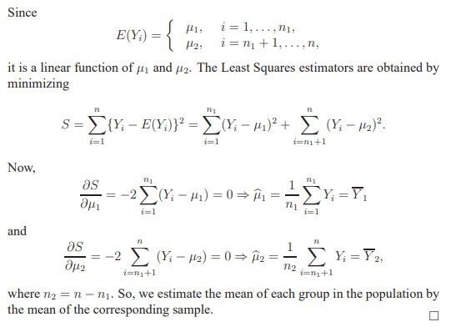
Example 1. Suppose that Y1, . . . , Yn1 are independent N (µ1, σ^2 ) random variables and that Yn1, . . . , Yn are independent N (µ2, σ^2 ) random variables. Find the least-squares estimators of µ1 and µ2.
Solution:

Slide 10
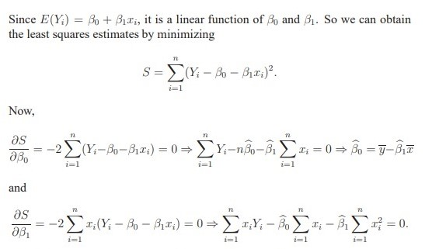
Example 2. Suppose that Yi ∼ N (β0+β1xi, σ^2) independently for i = 1, 2, . . ., n, where xi is some explanatory variable. This is called the simple linear regression model. Find the least-squares estimators of β0 and β1.
Solution:

Slide 11
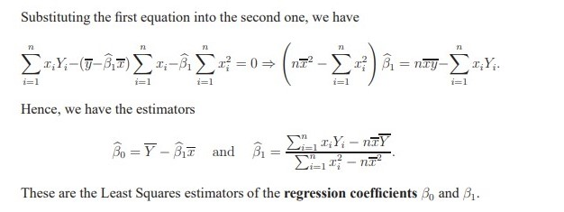

Slide 12
Exercise
Given data, (x1, y1), . . . ,(xn, yn), assume that Yi ∼ N (β0+β1xi , σ^2 ) independently for i = 1, 2, . . . , n and that σ^2 is known.
a. Show that the Maximum Likelihood Estimators of β0 and β1 must be the same as the Least Squares Estimators of these parameters.

Slide 13
b. The quench bath temperature in a heat treatment operation was thought to affect the Rockwell hardness of a certain coil spring. An experiment was run in which several springs were treated under four different temperatures. The table gives values of the set temperatures (x) and the observed hardness (y, coded). Assuming that hardness depends on temperature linearly and the variance of the r.vs is constant we may write the following model: E(Yi) = β0 + β1xi , var(Yi) = σ^2 . Calculate the Least square estimates of β0 and of β1. What is the estimate of the expected hardness given the temperature x = 40?
Run: 1 2 3 4 5 6 7 8 9 10 11 12 13 14
X: 30 30 30 30 40 40 40 50 50 50 60 60 60 60
y: 55.8 59.1 54.8 54.6 43.1 42.2 45.2 31.6 30.9 30.8 17.5 20.5 17.2 16.9

Slide 14
References
Online Video Link-
https://www.youtube.com/watch?v=pXjaMY29k1g&ab_channel=nptelhrd
https://www.youtube.com/watch?v=y5INeKvfpcQ&ab_channel=BenLambert
Textbooks / Reference Books
Text Books
T1: Advanced Engineering Mathematics by R.K. Jain and S. R. K. Iyengar, Narosa Publications.
T2: Probability and Statistics for Engineers and Scientists by Sheldon M. Ross, Academic Press.
Reference Books
R1: Fundamental of mathematical Statistics by SC Gupta and VK Kapoor, S. Chand Publication.
R2: Probability by Lipschitz, Schaum outline series, Mc.Graw hill Publication.

Slide 15
References
Books:
Hastie, Trevor, et al., The elements of statistical learning. Vol. 2. No. 1. New York: Publisher: Springer, Edition: Second Edition (2009), ISBN: 978-0387848570
Practical Statistics for Data Scientists: 50 Essential Concepts, Authors: Peter Bruce, et al, Publisher: O'Reilly Media, Edition: Second Edition (2020), ISBN: 978-1492072942
Research Papers:
Carmichael, Iain, and J. S. Marron. "Data science vs. statistics: two cultures?." Japanese Journal of Statistics and Data Science 1.1 (2018): 117-138.
Hardin, Johanna, et al. "Data science in statistics curricula: Preparing students to “think with data”." The American Statistician 69.4 (2015): 343-353.
Websites:
https://365datascience.com/resources-center/course-notes/statistics/
https://www.geeksforgeeks.org/7-basic-statistics-concepts-for-data-science/
Videos:
https://www.youtube.com/playlist?list=PLZ2ps__7DhBYrMs3zybOqr1DzMFCX49xG

Slide 16
THANK YOU
For queries
Email: madan.e13485@cumail.in

